Slide 1
DYB Speaking Evaluations
Spreadsheet Guide

Slide 2
The Various Sheets
01
02
03
04
Instructions
Options
Mostly skippable
Importing your signature
Choosing user preferences
Creating new class sheets
Importing from a previous version
Customizing winner certificates
MacOS Users
Classes
An annoying bug
Downloading a required file
Custom message dialogs
File and folder permission requests
System Events and Osascript dialogs
Class Information
Student names, scores, comments, and notes.
Class Winners
Action Buttons

Slide 3
01
Instructions

Slide 4
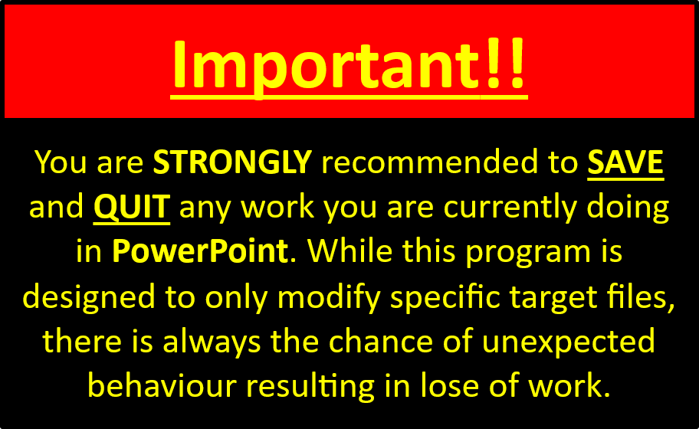
Instructions
While this slide does contain some helpful information, it hasn’t been updated in a while, and some of what it discusses has been automated.
The only two important bits on here that still apply to everyone are the “Important!!” message (seen on the right of this slide) and “Bug Reporting” (included below).
Reporting Bugs: (Feature requests also welcome.)
If you discover what you suspect to be a bug, I am happy to try to fix it. To make reproducing the error easier, please write a message (a Word or txt file) letting me know what you were doing before encountering the problem. Then, add both that file and your current copy of this spreadsheet into a zip file. You can either ask your team leader to send it to me via Kakao Talk, or you can email it to me at dyb.warrenfeltmate@gmail.com.
Please also include the following details:
- OS & Version (e.g. Windows 11 or MacOS 14.7.3)
- MS Office version (e.g. Microsoft 365 or Office 2016)
- Do you use cloud storage (e.g. OneDrive, iCloud, Google Drive)? If so, which?
- Where did you save this file? (Please send the complete path.)
- Was the Resources folder successfully created? If so, what files are present in it?
- What button did you click, if any?
- What error message, if any, was displayed?
- Did you install SpeakingEvals.scpt (MacOS only)?

Slide 5
02
Options

Slide 6



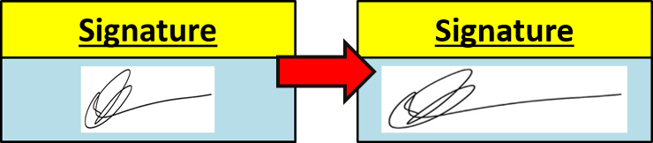
Options – Embedding Your Signature
This will automatically add a copy of your signature to each report instead of having to manually sign each.
The instructions to do so can be found on the Options sheet, but the basic idea is that once you have a digital image of you signature (.png or .jpg with a white background), you can simply click on the “Import Signature” button to select it and insert it into the spreadsheet.
After inserting it, the grey “Signature Missing” button should turn into a green “Signature Embedded” one. You can also click on either of these buttons to enable/disable it being inserted into the generate reports.
There is an occasional odd behaviour, where Excel will change the dimensions of the image in an odd way. This is a result of the way Excel handles shapes. If you need to resize the image of your signature, you can simply click on it and resize it, the same way you would in PowerPoint. Just make sure the image fits within the confines of the blue box.

Slide 7
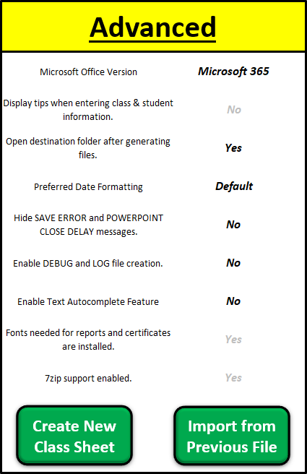
Options – User Preferences
Options with black text can be changed. Options with grey text are either
presently disabled (code is still being finalized/updated) or simply report
status (e.g., if the needed fonts were successfully installed).
Most can be left as their defaults, but here is a quick overview of each:
Microsoft Office Version: Currently only helps ensure the spreadsheet layouts
appear correctly. At present, this only needs to be
changed if you are using MS Office 2016.
Display tips when…: A yellow box will appear with helpful information
related to the cell you are currently editting.
Open destination…: After successfully creating reports or certificates, the
folder where the files have been saved to will open.
Preferred Date…: This will change how the date appears on reports
and certificates.
Hide SAVE ERROR…: Toggle whether a message appears when starting to
generate reports/certificates. This message contains
information about an odd PowerPoint quirk. After
reading it, it’s safe to set this to Yes.

Slide 8
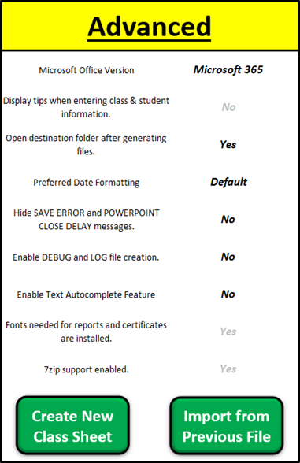
Options – User Preferences
Options with black text can be changed. Options with grey text are either
presently disabled (code is still being finalized/updated) or simply report
status (e.g., if the needed fonts were successfully installed).
Most can be left as their defaults, but here is a quick overview of each:
Enable DEBUG and…: Toggles whether a log file will be generated after each
action. The goal is to help make finding and fixing any
bugs you encounter easier. These will be stored in the
Logs folder in the same location as the spreadsheet.
By default, this is set to No. If you encounter a bug,
it would be helpful if you set this to Yes, repeat the
same actions, and include your log files when you
submit a bug report.
Enable Text Auto…: Excel predicting what you wish to enter in a cell has
been the cause of many teachers’ frustrations when
entering grades, so by default, I disable it. When you
close the spreadsheet, it is coded to be re-enabled.
Fonts & 7zip: These values simply report if the files were succesfully
downloaded and installed. Both should report Yes.

Slide 9
Options –New Class Sheets & Importing Data
These features have been added to simplify a pair of common tasks that have caused some teachers hesistation about using this spreadsheet, feeling it is too complicated (especially when needing to update to a newer version of the spreadsheet).
Create New Class Sheet: Click this button to create a fresh class sheet. You can then right-click on the new tab to rename it and/or change the tab’s colour.
Import from Precious File: By clicking this button, you will be asked to select a previous version. It will then examine that file and import all the classes and their data over.
Be careful with this feature!
If any of the class tabs/sheets share the same name, the data in the new file will be overwritten. Once these changes are saved (either by clicking save or Excel’s AutoSave feature), there is no way to get the previous data back unless you have a backup.

Slide 10
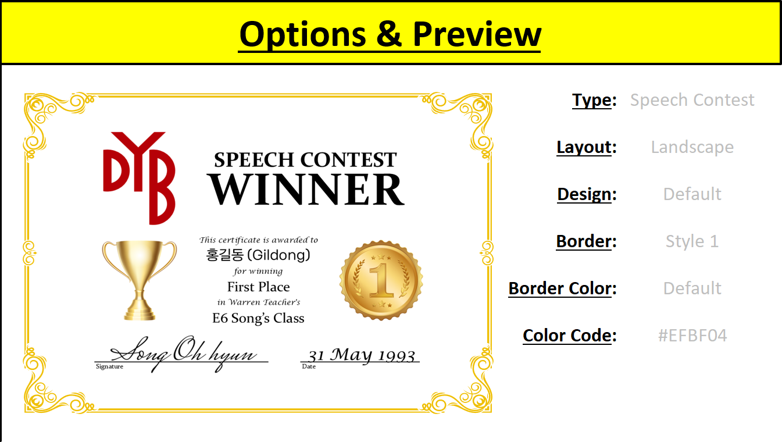
Options – Customizing Winner Certificates
Certificate creation works, but customization is presently disabled. Code to update sub-options when changing an option needs to be updated to the new code base.
Additional description will be added here once the code is more mature.

Slide 11
03
MacOS Users
Only visible to MacOS users.

Slide 12
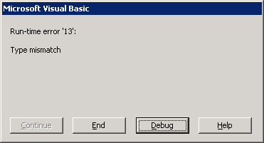
MacOS Users – An Annoying Bug
When opening the spreadsheet, if you receive a type mismatch error (as shown in the picture), you can mostly ignore it. Simply click end, close the spreadsheet, and open it again. This time, it should open without any trouble.
Near as I can tell, this has something to do with OneDrive and needed files not having local copies. In other words, your computer says the file exists, but OneDrive has removed the copy on your computer to save space. So, the file exists, but only in the cloud.
It’s on my to-do list to track down the exact nature and location where this bug occurs, but since it’s a relatively minor issue and it will be a lot of work to find and fix it, this bug is low on the priority list.

Slide 13


MacOS Users – Downloading a required file
Due to Apple’s much stricter security policies, it’s much more complicated to do even simple things. The spreadsheet will not function correctly without running this command first. While you could still try to enter data, you are all but guaranteed to experience numerous errors.
Luckily, this command only needs to be run once. Once installed, the grey “SpeakingEvals.scpt Missing” button will be replaced by a blue “SpeakingEvals.scpt Installed” one. There is a small chance you may need to close and reopen the speadsheet for the script to be properly detected.
To install it, follow these steps (also shown on the MacOS Users sheet):
Open a Terminal window. Either press Command(⌘) + Spacebar to open Spotlight and search by typing "Terminal“. (You can alternatively press Command(⌘) + Shift + U to open the Utilities folder and find it there.)
Then, copy and paste ALL of the following command into the terminal window.
curl -L -o ~/Library/Application\ Scripts/com.microsoft.Excel/SpeakingEvals.scpt https://github.com/papercutter0324/SpeakingEvals/raw/main/AppleScript/SpeakingEvals.scpt

Slide 14
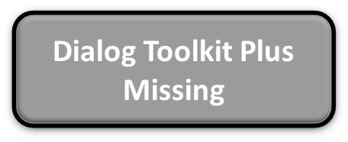

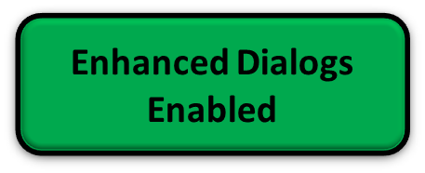

MacOS Users – Custom Message Dialogs
Some users have expressed a dislike for the default MacOS-style message dialogs (most commonly that the text is too small and/or troublesome to read). To help with this, I added support for a custom dialog window to make it more comfortable.
To enable these, however, you will be asked to enter your password (only once), so they aren’t automatically installed the first time you use this file. Your password is required simply to create the folder where this script file needs to be placed. Once this folder is created, you will never be asked to enter it again.
To install support, simply click on the red “Enhanced Dialogs Disabled” button and enter your password.
Dialog Toolkit Plus Buttons: If you haven’t installed this yet, a grey button saying “Dialog Toolkit Plus Missing” will be shown. After installation, a blue “Dialog Toolkit Plus Installed” button will be shown.
Enhanced Dialogs Buttons: Same as above, if not yet installed, a red “Enhanced Dialogs Disabled” button will be shown. Once installed, a green “Enhanced Dialogs Enabled” button will be shown. Once installed, clicking these buttons will toggle the custom dialogs on
and off.
Placeholder for showing a comparison between the default and custom dialogs.

Slide 15
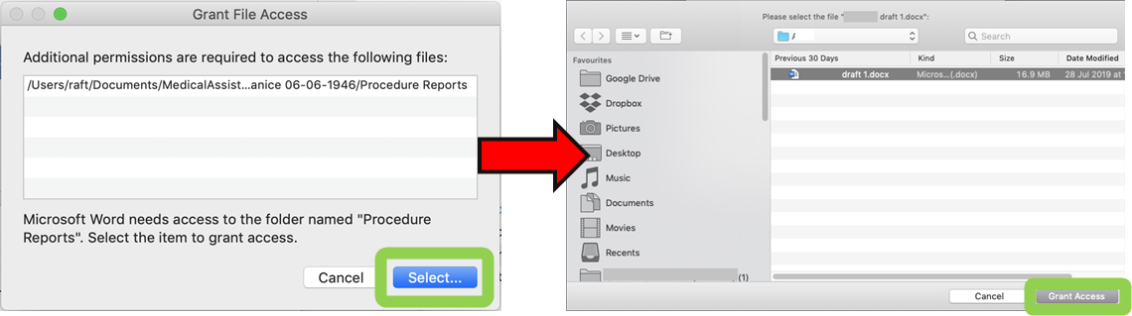
MacOS Users – File and Folder Permission Requests
Also due to Apple’s stricter security controls, Excel needs to be granted access to any files and folders outside of its default access permissions. Unless you are a new Mac owner, you have seen similar requests before.
When you see such a request, simply click on ‘Select’ in the first dialog, and then click on ‘Grant Access’ in the subsequent one. Do not change the folder/file it is requesting access to; just click on the noted buttons.
The first few times you open this file or generate reports/certificates, you will see a bunch of these requests. However, the good news is that permissions are typically remembered and permanent, so you will quickly see fewer and fewer of these.
Notes:
The first time you generate proofs, reports, or certificates, PowerPoint will also need to request a few permissions, so keep an eye out for its icon to start bouncing.
In testing, one teacher (out of 8) kept seeing more of these than expected. If you have the same issue, feel free to contact me. (As of yet, no teachers from other branches have mentioned this problem.)

Slide 16
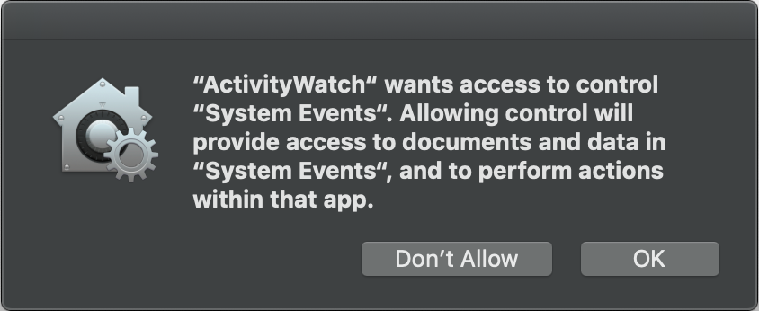
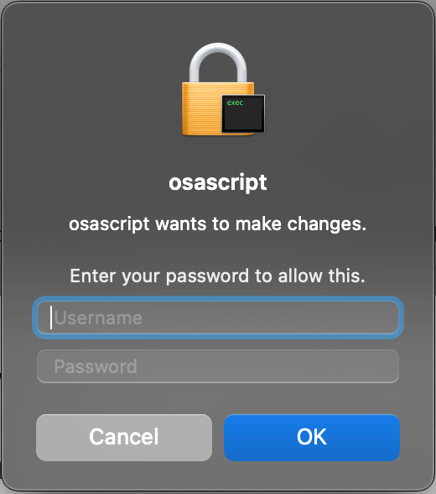
MacOS Users – System Events and Osascript Dialogs
System Events: These are simply Excel asking for permission to create or delete the files and folders the
spreadsheet needs or to communicate with PowerPoint or 7zip. They appear somewhat
randomly, so you may see them a few times one day, but not at all the next day, even if do
the exact same thing.
Osascript: As mentioned, there is one time when a folder needs to be created in a secure spot.
Once this folder has been created, the spreadsheet should never prompt you again
(unless you manually find and delete this folder).

Slide 17
04
Classes

Slide 18
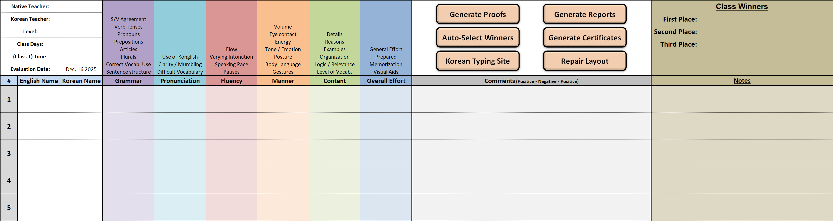
Classes
Sections Covered:
Class Information
Student Names
Grades
Comments & Notes
Class Winners
Action Buttons
1
6
5
2
3
4

Slide 19
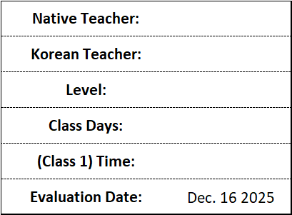
Classes – Class Information
Native Teacher: Your name written in English without ‘tr.’ or other suffixes.
Korean Teacher: Your KT’s name written in Korean. If you are unable to type in
Korean, see section 6 (Action Buttons).
Level: Type and/or select the class’s level from the dropdown list.
Class Days: Type and/or select which days you see this class.
(Class 1) Time: Type and/or select the time of your first class with them each
week.
Evaluation Date: Enter the date you performed (the majority of) the evaluations.
*
*
*
* Notes about typing these values:
Each character you type will reduce the number of suggestions shown in the dropdown list.
If you type the whole value, it must match the intended value as shown in the dropdown list.

Slide 20
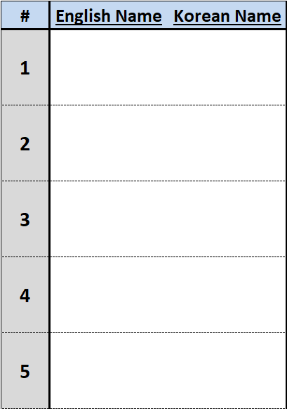
Classes – Student Names
#: Simply an index number. For the most part, you don’t need to worry
about these. The only thing to keep in mind is that there cannot be
any blank lines before the final student’s record when you want to
generate reports and/or certificates.
English Name: Mostly self-explanatory. If a student doesn’t have one, simply use the
romanized version of their Korean name. While unlikely you will
encounter this, it is recommended to enter an English name with less
than 40 characters (letters, spaces, and punctuation).
The code is designed to catch and correct common mistakes. If there
is a name you cannot enter correctly, please pass it along, and I will try
to add a rule. (E.g., Allowing ‘Y.G.’ instead of ‘Y.g.’, which is planned.)
Korean Name: Please enter their names in Korean; if you cannot type in Korean, see
section 6 (Action Buttons).
If you enter a two- or four-syllable name, the cell will be shaded yellow.
Check that you have entered the student’s name correctly; while names
of these lengths exist, they are fair uncommon.
If you enter a one-syllable name or one that is five or more syllables in
length, the cell will be shaded red. Please ensure you have typed their
name correctly and in Korean.

Slide 21
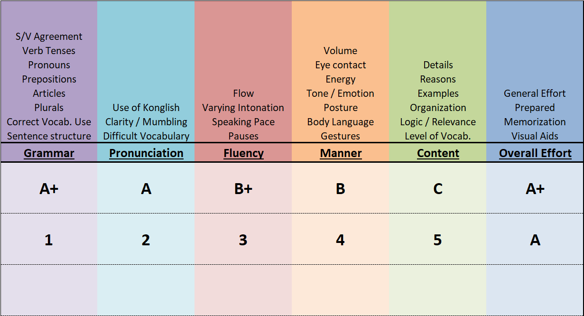
Classes – Grades
This is one of the easiest sections.
Valid Grades: C / B / B+ / A / A+ or 1 / 2 / 3 / 4 / 5
C = 1 to A+ = 5
Typos: Most common typos will trapped and
corrected to your intended score.
If a correction isn’t possible, a message
will pop up to inform you, and the
invalid score will be erased.
Normalizing: There’s no issue with both letter and
numeric grades being present. They
will all be normalized to letter grades
when you either…
      Generate reports or certrificates,
      Press the “Repair Layouts” button
      Re-open the spreadsheet

Slide 22
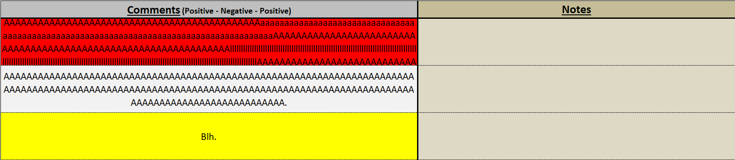
Classes – Comments & Notes
Another simple section.
Comments: As noted, comments need to follow the positive-negative-positive format. However, when writing
comments, the feedback needs to be written using complete sentences. It is common for both the
students and their parents to read these (or have it translated by the Korean teachers over the
phone), so it’s important that proper grammar and writing style are used here.
If the comment is too short (less than 80 characters), a message will pop up notifying you of this,
and the cell will be shaded yellow. This won’t prevent you from generating the reports, but you
should try to add some more details to your comment.
If the comment is too long (over 960 characters), a message will pop up notifying you of this and
an approximate number of characters to trim, and the cell will be shaded red. A comment of this
length will be hard to properly fit into the comment section of the report template.
Notes: Intended to allow note taking during the evaluations for you to refer to later. This section is purely
for your use, and anything typed here will be completely ignored when generating files.

Slide 23
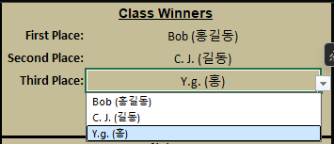
Classes – Class Winners
For each student that has both their English and Korean name entered and has values for all of their grades entered, their names will be added to the list of names in the dropdown menu.
To see the menu, click into the name cell for first, second, or third place. You’ll see a down arrow appear on the right of this cell. Click on it to reveal the list of names. You can then manually select who you feel should win each place.
To make things even simpler, the Auto-Select Winners button will be covered in an upcoming slide. However, even if you use said button, you can still manually change who wins each place.
After each placement is selected, their respective names will be shaded gold, silver, or bronze.

Slide 24
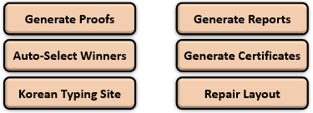
Classes – Action Buttons
Generate Proofs: This button will create .pptx versions of the reports. Excel doesn’t have a spell- or grammar-
check feature, so after you have entered all the information for each student and written
their comments. You can then open the generated .pptx files in PowerPoint to check for
mistakes and fix them in on the spreadsheet. As a note, it might take about 30 seconds for
PowerPoint to full load the spell- and grammar-check features, so you may need to wait a
few seconds for the blue and red underlines to appear.
Generate Reports: This button will create .pdf copies of each report. After they are generated, they will auto-
matically be added to a .zip file. This way, you can send a single file (per class) to each of
your KTs.
Generate Certificates: This will generate winner certificates for the top three students. If you have not already
chosen winners, or the code suspects your winner selections may be incomplete, a
message will appear asking if you wish to automatically select winners now.
Notes:
Each class will be stored in its own subfolder
Any existing reports, certificates, or zip files currently in a class’s subfolder will be deleted or overwritten when new files are being generated.

Slide 25
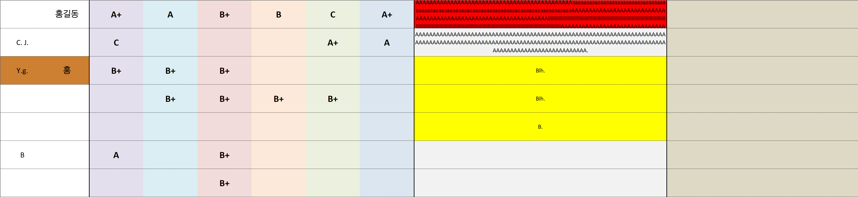
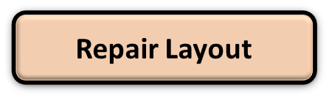
Classes – Action Buttons
Auto-Select Winners: Mostly self-explanatory. Each student with both names and all grades entered will be
examined, and the top three students will be automatically selected as winners. If two
or more students have the same score, the student who appears earlier in the class list
will be selected first. As noted before, you can always manually change the selection.
Korean Typing Site: If you are unable to type in Korean, you can use this site. It’s surprisingly convenient for
whenever you need to typing in Korean. You can either click on each letter with your
mouse or type using your keyboard. The site will automatically convert the key you
type to the equivalent key on a Korean keyboard. You can then copy and paste this
into the spreadsheet.
Repair Layout: If you think you’ve broken the spreadsheet somehow, relax. I don’t think you’ll discover
a way to break something that my team hasn’t already tried. Just click this button and
everything will return to normal. As mentioned before, this button will also normalize
all grades to letter grades.

